Slide 1
SAP EWM EXTENDED WAREHOUSE MANAGEMENT TRAINING
AnubhavTrainings.com
www.anubhavtrainings.com

Slide 2

SAP EWM TRAINING
BY:-
Mr. Bijoy
www.anubhavtrainings.com
Notes:
https://unsplash.com/photos/uXB-7la5vqA

Slide 3
SAP EWM TRAINING (Day 07)
AnubhavTrainings.com

Slide 4
Resource Management & Warehouse Monitor
Define Resource types, Define Queue types & Queue, Define Resource, Maintain User id to Resource
Test execution of different processes in RF
Warehouse Monitor Introduction
Various functionalities and Uses

Slide 5
Ewm Internal Transfers And Work Center
Ad Hoc Movement
Use
Ad hoc movements are unplanned goods movements that you create manually within a warehouse. This means that the decision to make an ad hoc movement is not controlled by the system. Instead, it is triggered manually. Ad hoc movements do not have a preceding document. An ad hoc movement may be necessary for the following reasons:
The wrong product is located in the storage bin.
You have to take the product to another storage bin due to damage, for example for a quality inspection.
You want to take a product to the appropriate storage bin for scrapping.
You have to empty an aisle or storage bin for safety reasons.
You want to perform unplanned rearrangement movements.
You have to clear away stock lying around in the warehouse.

Slide 6
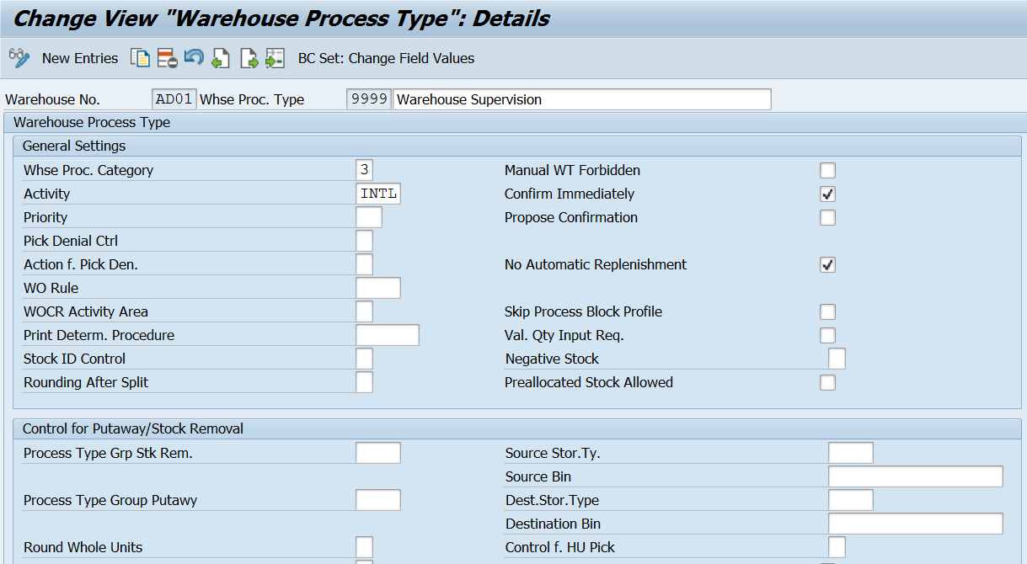
Internal Stock Transfer –
Creating Warehouse task for Product: /SCWM/ADPROD
Creating Warehouse task for HU : /SCWM/ADHU
Creating Posting Change - /SCWM/POST (Warehouse Process type – 4010)
Warehouse Process type 9999 (for Internal transfer)

Slide 7
Work Center Configurations
Define work center layout
Define storage type for work center (storage role = e)
Define storage section
Create bin for your work center (master data)
Define work center
Assign your storage bin to your work center - /scwm/tworkst (master data)
Transaction code: /SCWM/PACK

Slide 8
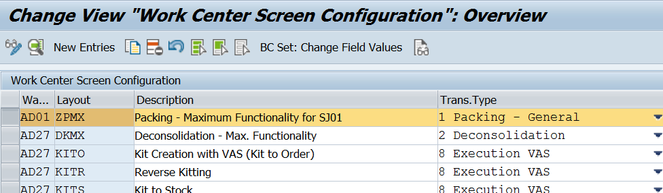
Define Work Center Layout
EWM > Master data > Work Center > Specify Work Center Layout
Create the various layouts in order to adapt the interface to the required work processes for a work center. Specify which functions are available, and which tab pages should be displayed.
Example - In the work center, the tab page for displaying open warehouse tasks is not required. You can use a layout to hide this tab page.

Slide 9
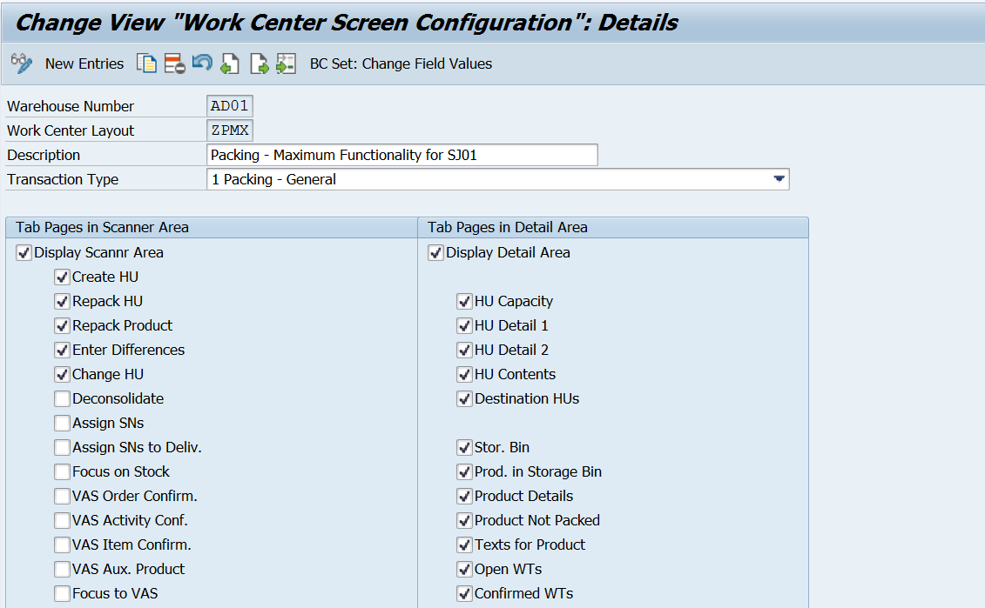

Slide 10
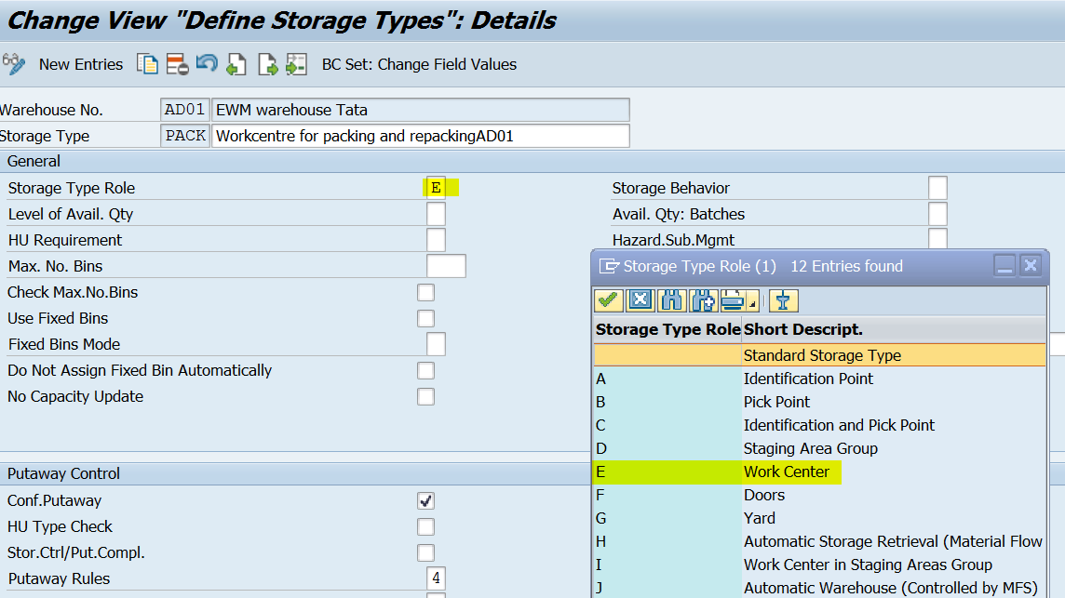
Define storage type for work center (Storage role = E)

Slide 11
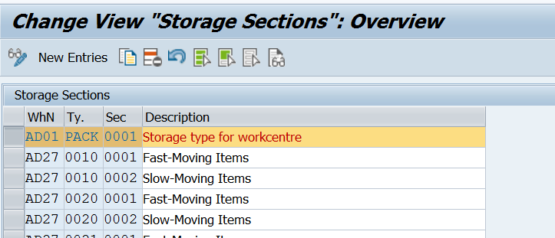
Define storage section

Slide 12
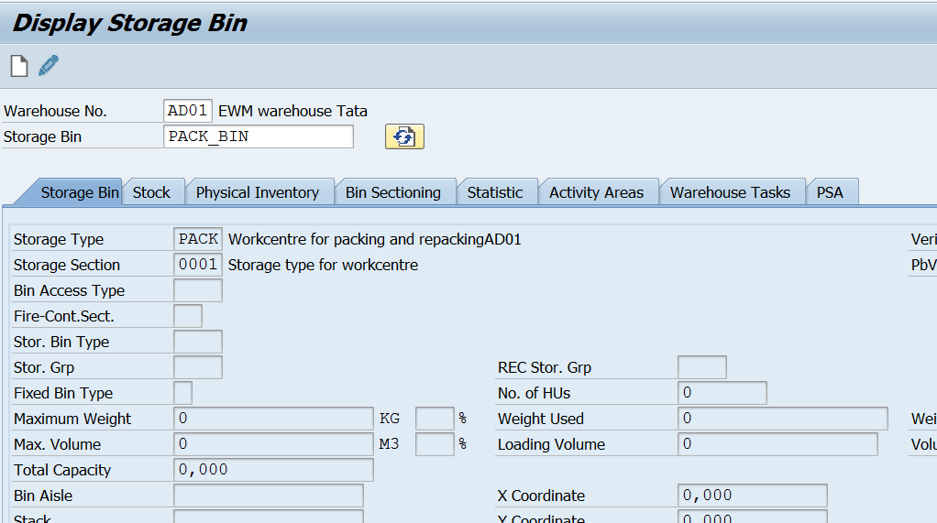
Create bin for your work center (Master data)
www.anubhavtrainings.com

Slide 13
Define work center
A work center in a Warehouse is assigned to a storage type and a physical unit to perform packing, deconsolidation or weighing activities. Storage type assigned to a work center has a role of the work center, pick point or pick point and identification. You can also configure more than one work center in a storage type.
A Work Center can be used for the following processes −
Packing
Deconsolidation
Counting
Quality check
www.anubhavtrainings.com

Slide 14
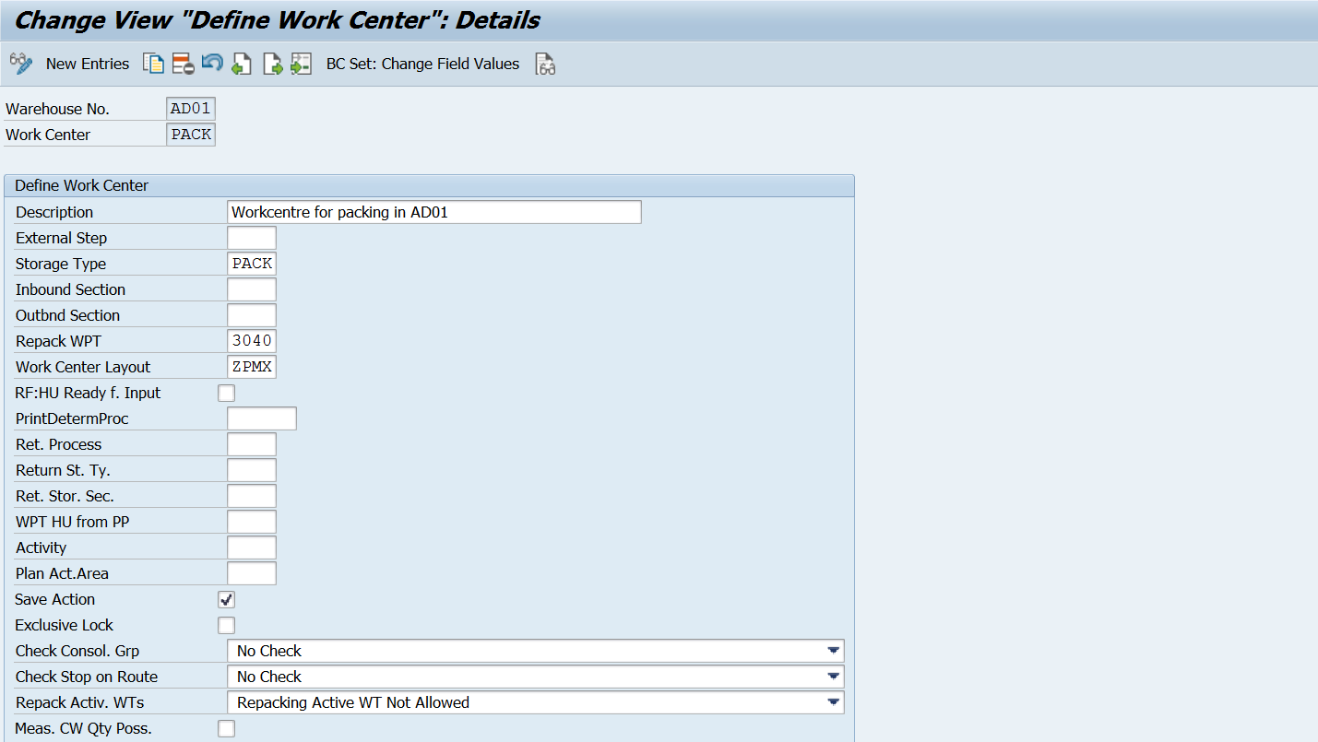
EWM > Master data > Work Center > Define Work Center

Slide 15
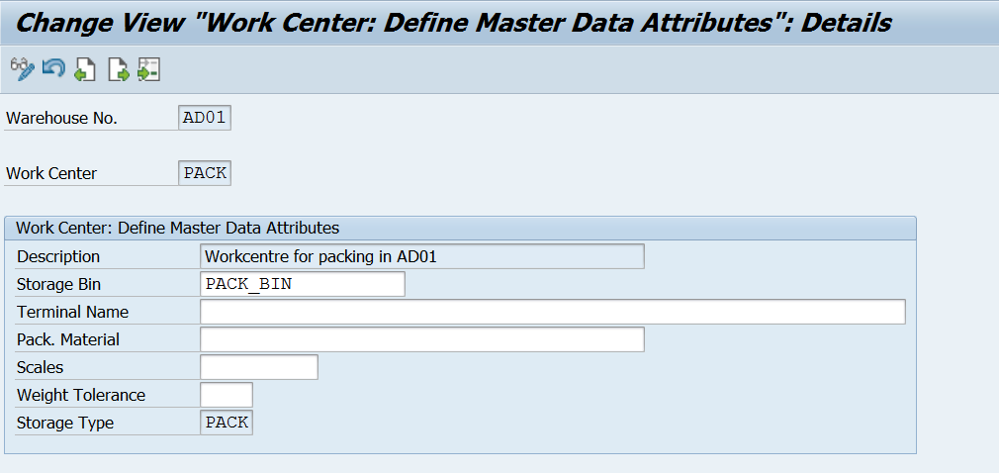
Assign your storage bin to your work center - /SCWM/TWORKST (Master data)
www.anubhavtrainings.com

Slide 16
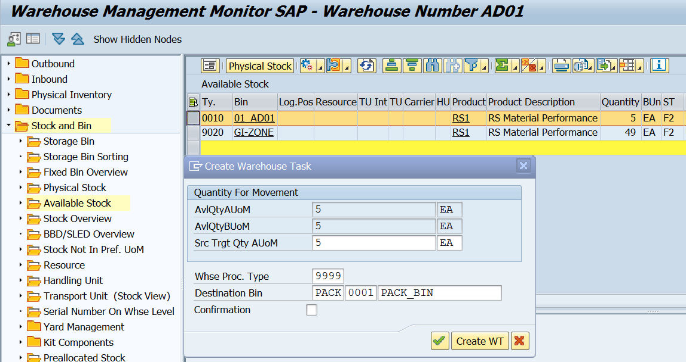
Test Scenario –
1. Create a Warehouse task for moving stock to PACK St type

Slide 17
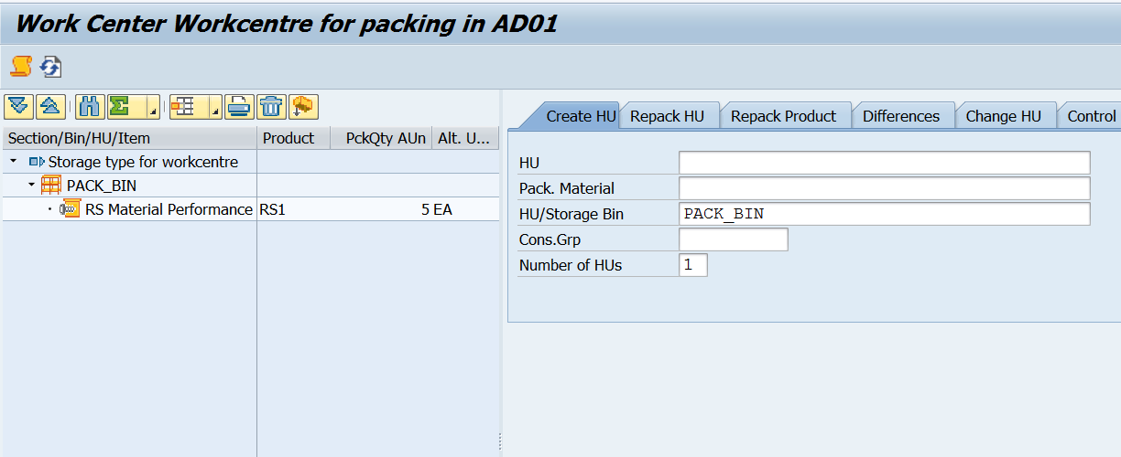
2. Go to tcode /scwm/pack

Slide 18
3. Create HUs for Repacking

Slide 19
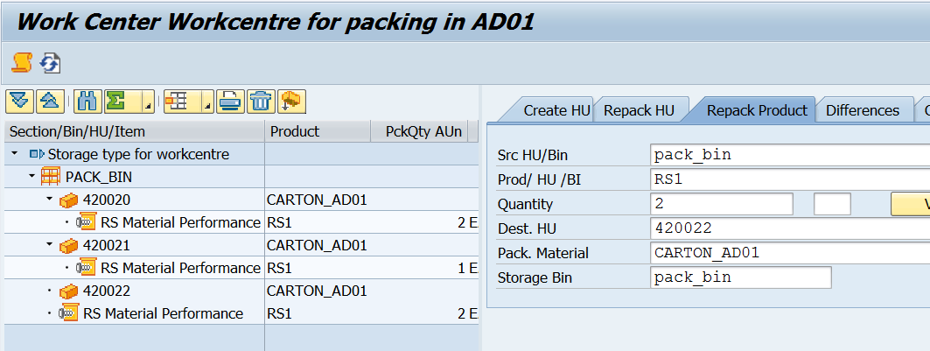
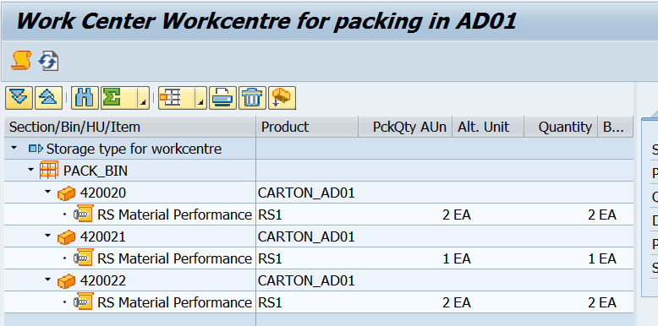
4. Repack the Product

Slide 20
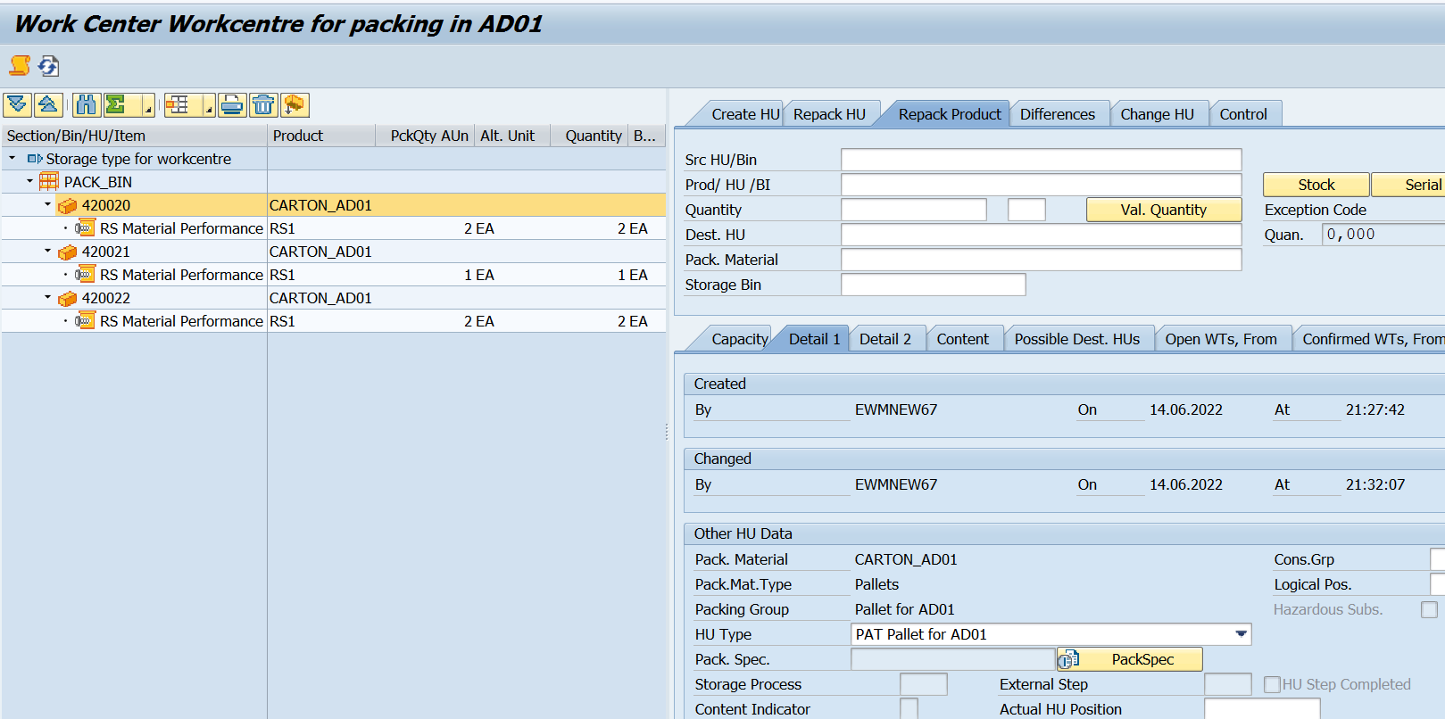
Double Click on HU Number (System will show details in following tabs which has been configured in Work center layout)
www.anubhavtrainings.com

Slide 21
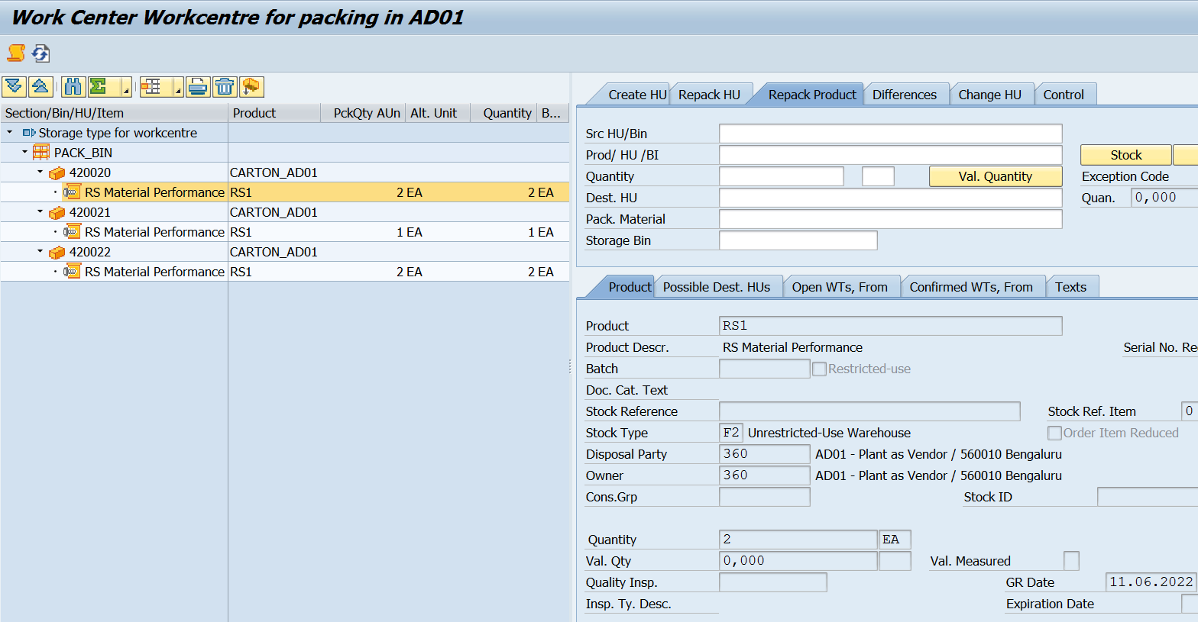
www.anubhavtrainings.com

Slide 22
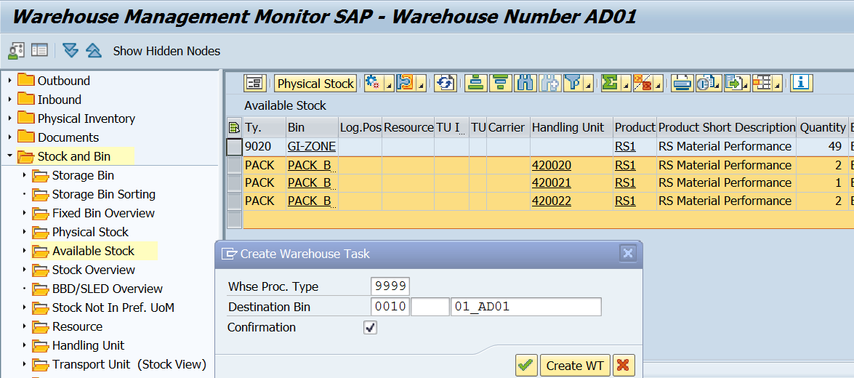
Move this stock from St type PACK to destination storage type-bin

Slide 23
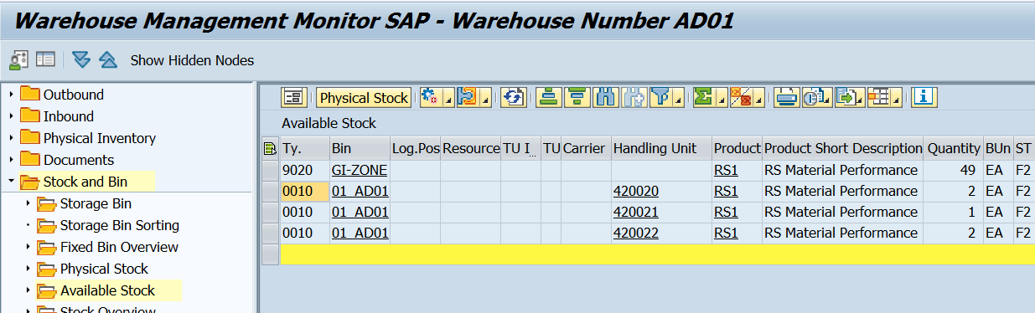

Slide 24


End of Session 07
www.anubhavtrainings.com

Slide 25

FEEL FREE TO ASK QUESTIONS

Slide 26

Feedback

Slide 27
THANK
YOU

Slide 28

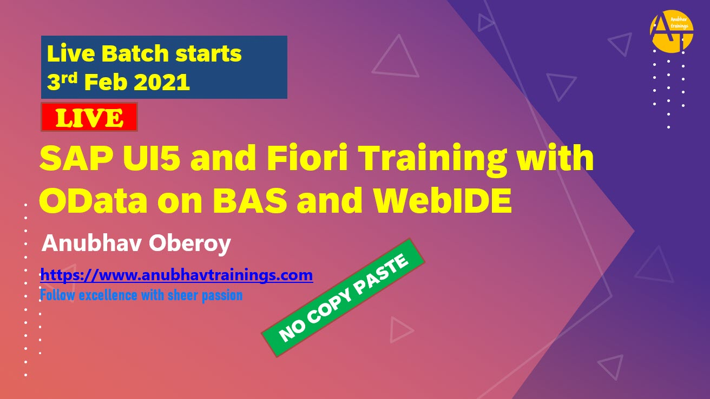

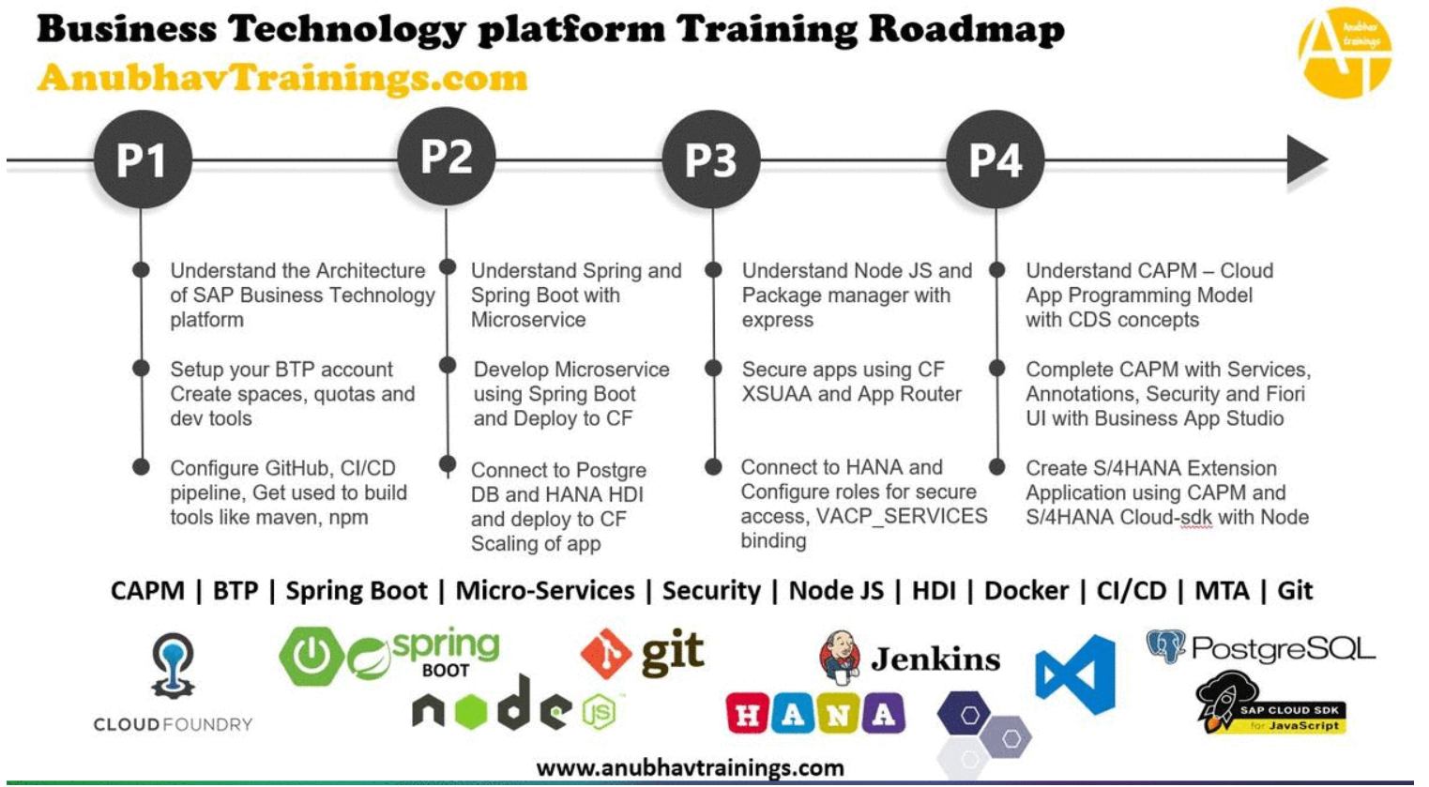
More from AnubhavTrainings.com

Slide 29






We’re committed to empower you to be
#FutureReady
through powerful training solutions.
We build the workforce of the future.
250+
Corporate Clients
30,000+
Learners Trained
25000+
Learners Placed
FREE WEBINARS
Sign up for free webinars with industry experts every fortnight!
Enroll Now!

Slide 30
FREE WEBINARS
Sign up for free webinars with industry experts every fortnight!
Contact us today!
www.anubhavtrainings.com

